Slide 1
Statistical Learning - Probability and Distributions- Week 2

Slide 2
Topics covered in Week 2
Probability – Meaning and concepts
Rules for Computing Probability(Multiplicative and Addition rule)
Marginal probability
Bayes’ theorem
Probability Distribution and types

Slide 3
Session Agenda
Probability – Meaning and concepts
Rules for Computing Probability(Multiplicative and Addition rule)
Marginal probability
Bayes’ theorem
Probability Distribution and types
Case study
Questions

Slide 4
Probability – Meaning & Concepts
Probability refers to chance or likelihood of a particular event-taking place.
An event is an outcome of an experiment.
An experiment is a process that is performed to understand and observe possible outcomes.
Set of all outcomes of an experiment is called the sample space.

Slide 5
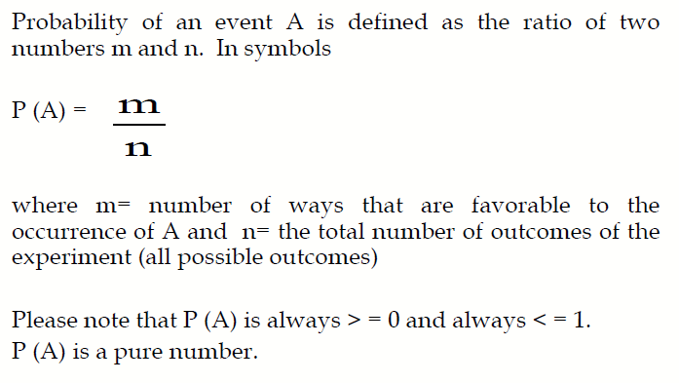
Definition of Probability

Slide 6
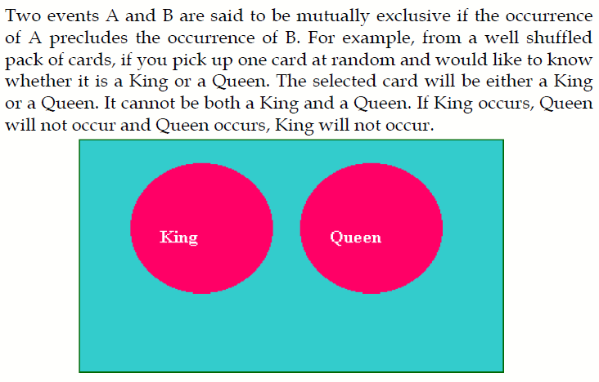
Mutually Exclusive Events

Slide 7
Independent Events
Two events A and B are said to be independent if the occurrence of A is in no way influenced by the occurrence of B. Likewise occurrence of B is in no way influenced by the occurrence of A.

Slide 8
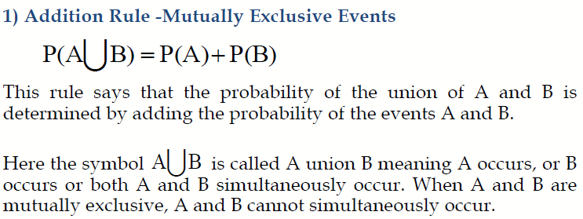
Rules for Computing Probability

Slide 9
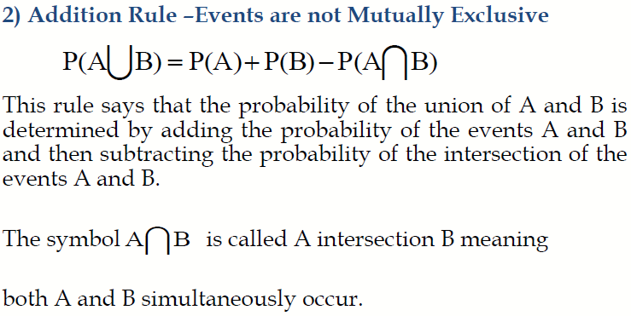
Rules for Computing Probability

Slide 10
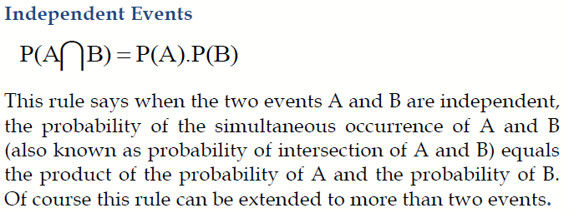
Multiplication Rule

Slide 11
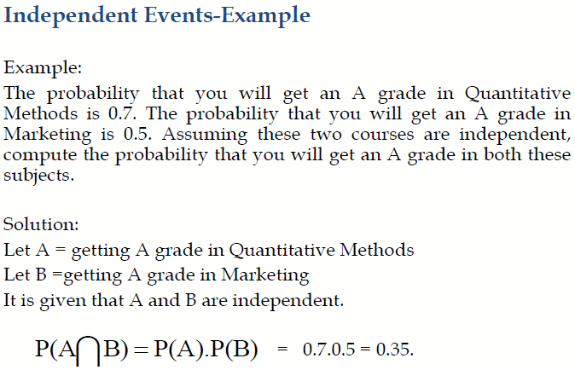
Multiplication Rule

Slide 12
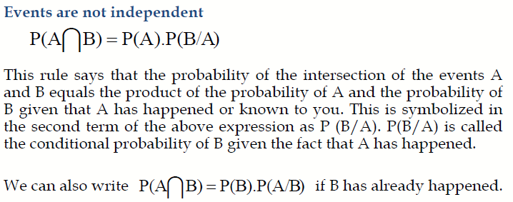
Multiplication Rule

Slide 13
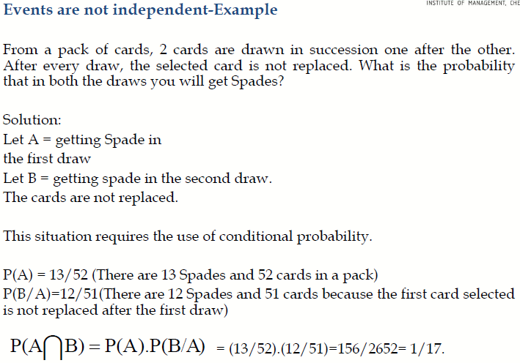
Multiplication Rule

Slide 14
Marginal Probability
Contingency table consists of rows and columns of two attributes at different levels with frequencies or numbers in each of the cells. It is a matrix of frequencies assigned to rows and columns.
The term marginal is used to indicate that the probabilities are calculated using a contingency table (also called joint probability table).

Slide 15
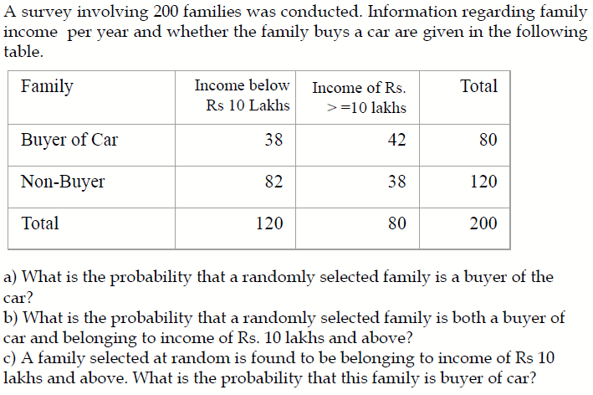
Marginal Probability - Example

Slide 16
Solution
a) What is the probability that a randomly selected family is a buyer of the Car?
80/200 =0.40.
b) What is the probability that a randomly selected family is both a buyer of car and belonging to income of Rs. 10 lakhs and above?
42/200 =0.21.
c) A family selected at random is found to be belonging to income of Rs 10 lakhs and above. What is the probability that this family is buyer of car?
42/80 =0.525. Note this is a case of conditional probability of buyer given income is Rs. 10 lakhs and above.

Slide 17
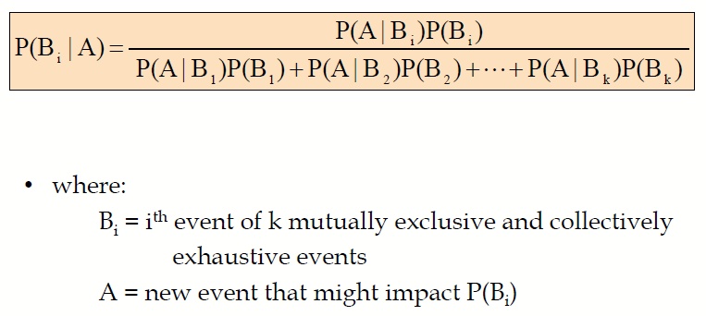
Bayes’ Theorem

Slide 18
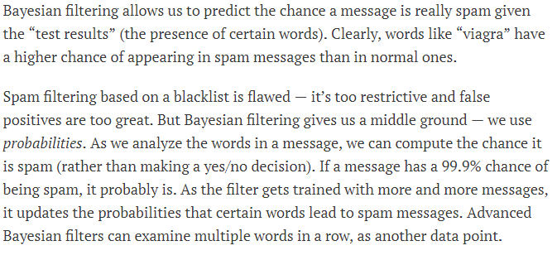
Bayes’ Theorem Example

Slide 19
What is a Probability Distribution
In precise terms, a probability distribution is a total listing of the various values the random variable can take along with the corresponding probability of each value. A real life example could be the pattern of distribution of the machine breakdowns in a manufacturing unit.
The random variable in this example would be the various values the machine breakdowns could assume.
The probability corresponding to each value of the breakdown is the relative frequency of occurrence of the breakdown.
The probability distribution for this example is constructed by the actual breakdown pattern observed over a period of time. Statisticians use the term “observed distribution” of breakdowns.

Slide 20
Binomial Distribution
The Binomial Distribution is a widely used probability distribution of a discrete random variable.
It plays a major role in quality control and quality assurance function. Manufacturing units do use the binomial distribution for defective analysis.
Reducing the number of defectives using the proportion defective control chart (p chart) is an accepted practice in manufacturing organizations.
Binomial distribution is also being used in service organizations like banks, and insurance corporations to get an idea of the proportion customers who are satisfied with the service quality.

Slide 21
Conditions for Applying Binomial Distribution (Bernoulli Process)
Trials are independent and random.
There are fixed number of trials (n trials).
There are only two outcomes of the trial designated as success or failure.
The probability of success is uniform through out the n trials

Slide 22
Example for Binomial Distribution
A bank issues credit cards to customers under the scheme of Master Card. Based on the past data, the bank has found out that 60% of all accounts pay on time following the bill. If a sample of 7 accounts is selected at random from the current database, construct the Binomial Probability Distribution of accounts paying on time.

Slide 23
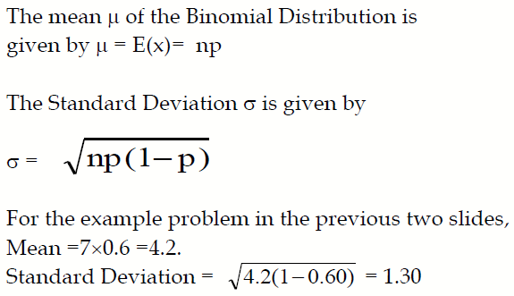
Mean and Standard Deviation of the Binomial Distribution

Slide 24
Poisson Distribution
Poisson Distribution is another discrete distribution which also plays a major role in quality control in the context of reducing the number of defects per standard unit.
Examples include number of defects per item, number of defects per transformer produced, number of defects per 100 m2 of cloth, etc.
Other examples would include 1) The number of cars arriving at a highway check post per hour; 2) The number of customers visiting a bank per hour during peak business period; 3) The number of pixels in the image that are corrupted.

Slide 25
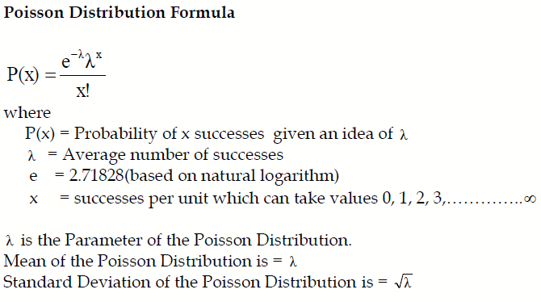
Poisson Probability Function

Slide 26
Example – Poisson Distribution
If on an average, 6 customers arrive every two minutes at a bank during the busy hours of working, a) what is the probability that exactly four customers arrive in a given minute? b) What is the probability that more than three customers will arrive in a given minute?

Slide 27
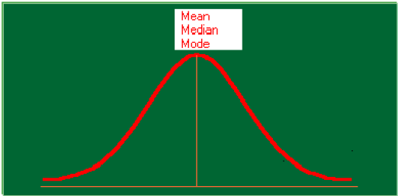
Normal Distribution

Slide 28
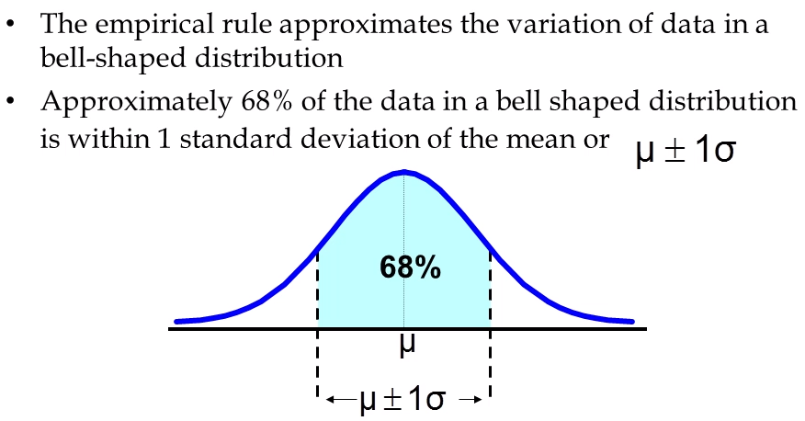
Normal Distribution

Slide 29
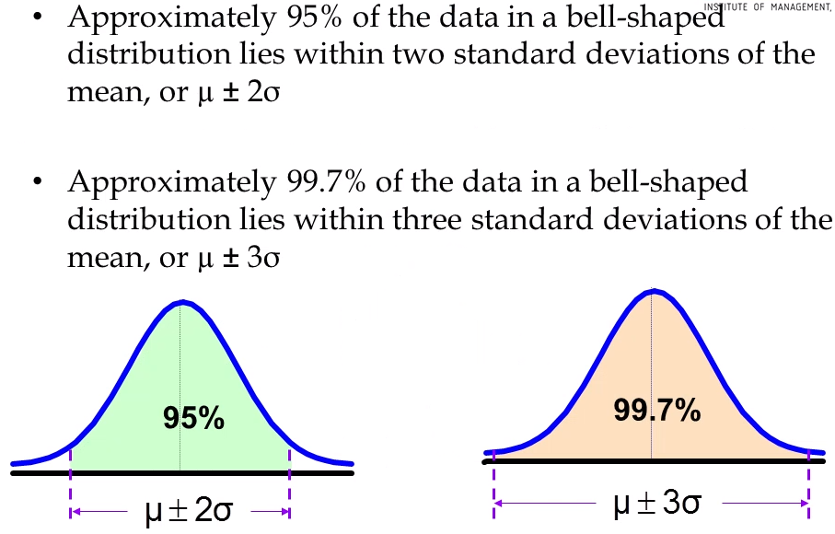
Normal Distribution

Slide 30
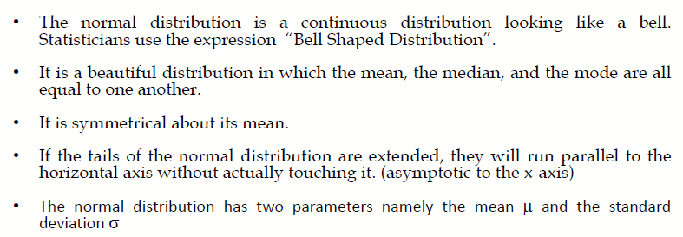
Properties of Normal Distribution

Slide 31
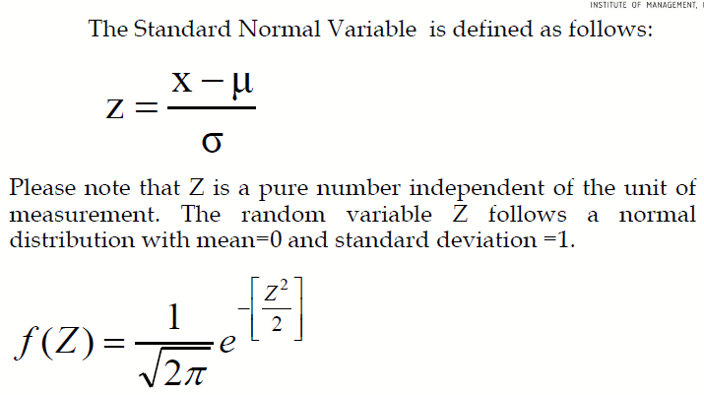
Standard Normal Distribution

Slide 32
Example Problem
The mean weight of a morning breakfast cereal pack is 0.295 kg with a standard deviation of 0.025 kg. The random variable weight of the pack follows a normal distribution.
a)What is the probability that the pack weighs less than 0.280 kg?
b)What is the probability that the pack weighs more than 0.350 kg?
c)What is the probability that the pack weighs between 0.260 kg to 0.340 kg?

Slide 33
Solution
z = (0.28-0.295)/0.025 = -0.6 p=0.27
z = (0.35-0.295)/0.025 = 2.2 , p=1-0.986 = 0.013
z1 =(0.34-0.29)/0.025 = 1.8
z2 =0.26-0.295/0.025 = -1.4, p=0.96-0.080=0.88

Slide 34
Let’s summarize what we have learnt….

Slide 35
Case Study
Examples on Joint Probability and Conditional Probability
Binomial Distribution
Poisson Distribution
Computing Binomial probabilities for service at a Fast-Food Restaurant
Case study on Business Statistics Course based on Poisson and Normal Distribution

Slide 36


Questions?

